Slide 1

Energy Consumption Analysis

Slide 2

Energy Consumption Analysis
A Data-Driven Exploration of Global Energy Trends Using SQL

Slide 3
Introduction
🔹Project Overview: This project analyzes real-world global energy data to uncover patterns and relationships between energy consumption, production, GDP, population, and emissions. Using SQL as the primary tool, the analysis provides insights into economic performance, environmental impact, and resource use efficiency.
🔹 Data Source:
Data derived from the U.S. Energy Information Administration (EIA).
Covers multiple countries and spans several years.
Includes 6 related tables: country, emission, population, production, gdp, consumption.

Slide 4
🔹 Key Goals:
Identify top and lowest performers in GDP, emissions, and energy usage.
Compare production vs. consumption trends.
Evaluate per capita impacts and efficiency ratios.
Track global energy and environmental trends over time.
🔹 Tools & Skills Used:
SQL: Data extraction, aggregation, and relational joins.
Data Cleaning: Standardization of text and formats.
Visualization: Graphs and charts to represent findings.

Slide 5
Problem Statement
Rising global energy demand, driven by economic growth and population expansion, increases greenhouse gas emissions. Understanding the relationship between energy usage, GDP, population, and emissions is crucial for balancing development with sustainability.
This project uses SQL to analyze multi-country energy data, uncover trends, compare production vs consumption, and evaluate per capita impacts — providing insights to guide sustainable energy strategies.

Slide 6
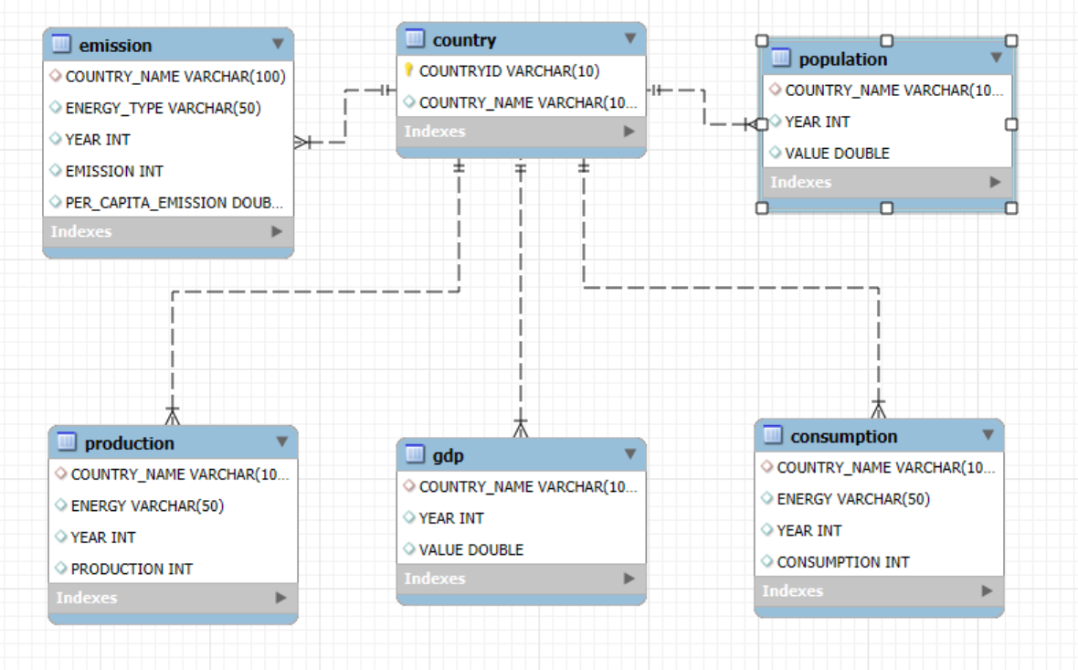
ER Diagram

Slide 7

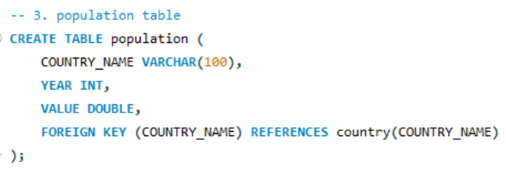
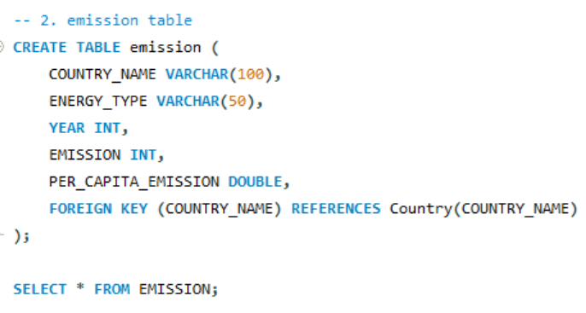
Tables

Slide 8
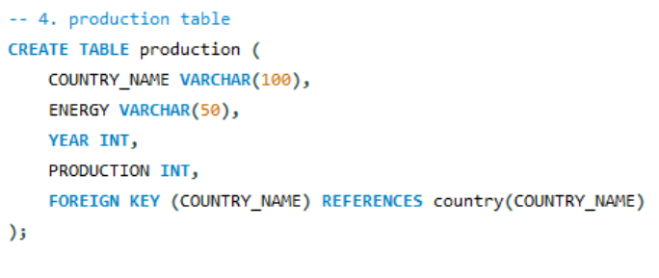

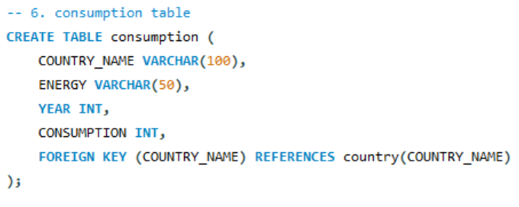
Tables

Slide 9
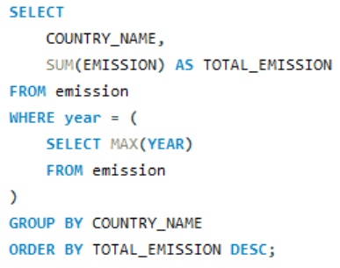
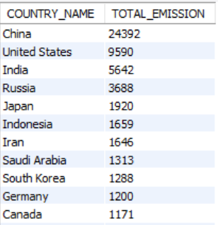
1.What is the total emission per country for the most recent year available?
General & Comparative Analysis

Slide 10
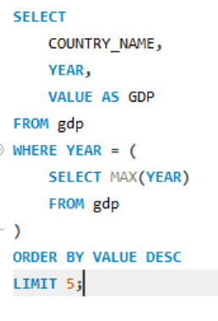
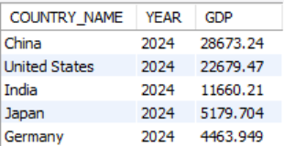
2. What are the top 5 countries by GDP in the most recent year?
General & Comparative Analysis

Slide 11
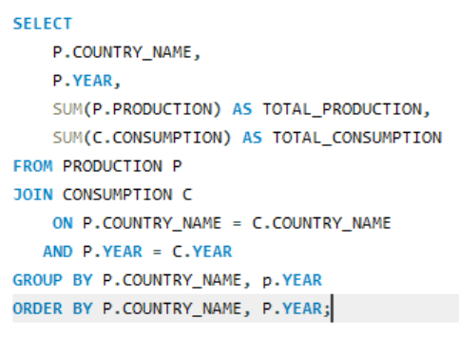
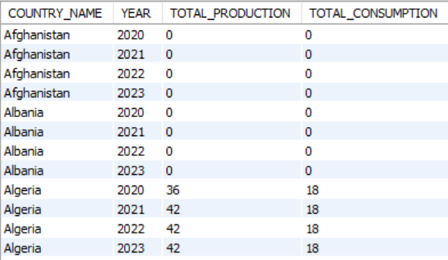
3. Compare energy production and consumption by country and year.
General & Comparative Analysis

Slide 12
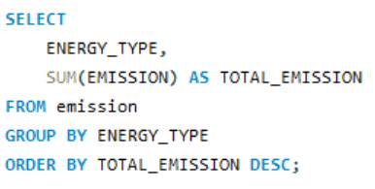
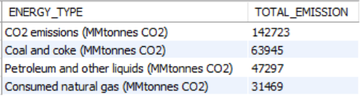
4. Which energy types contribute most to emissions across all countries?
General & Comparative Analysis

Slide 13
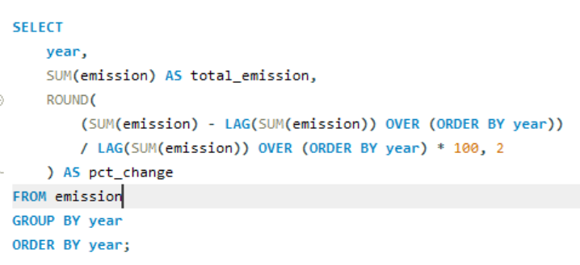
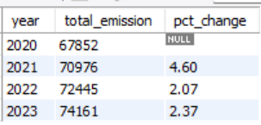
1. How have global emissions changed year over year?
Trend Analysis Over Time

Slide 14
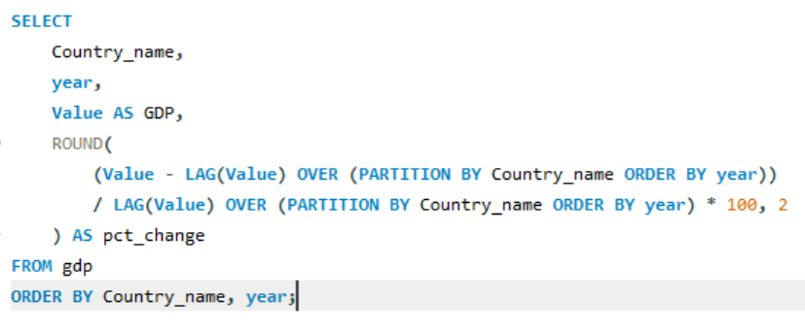
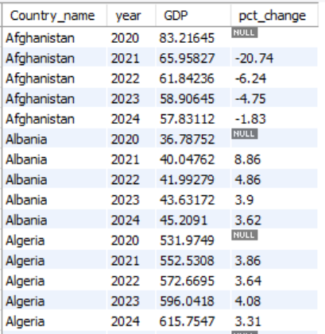
2. What is the trend in GDP for each country over the given years?
Trend Analysis Over Time

Slide 15
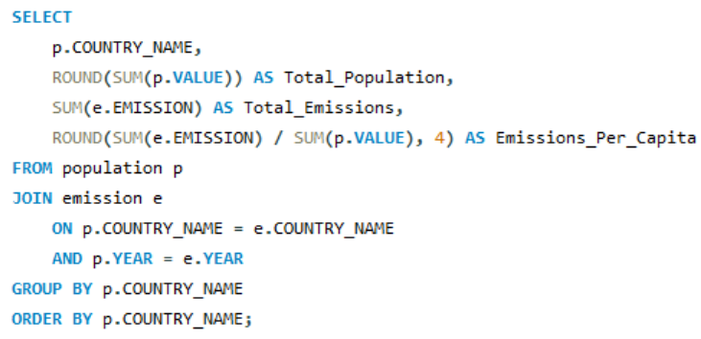
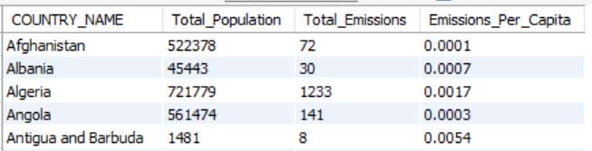
3. How has population growth affected total emissions in each country?
Trend Analysis Over Time

Slide 16
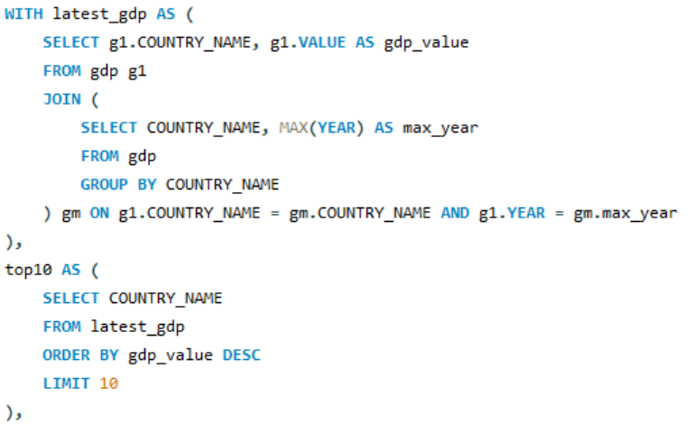
4. Has energy consumption increased or decreased over the years for major economies?
Trend Analysis Over Time

Slide 17
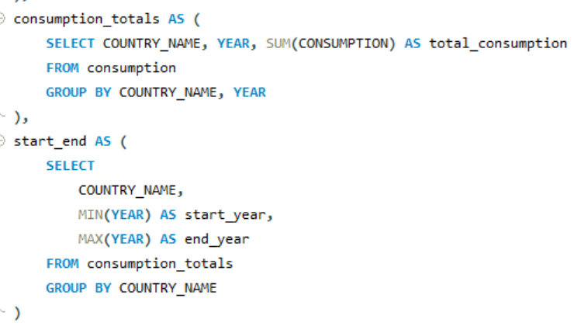
Trend Analysis Over Time

Slide 18
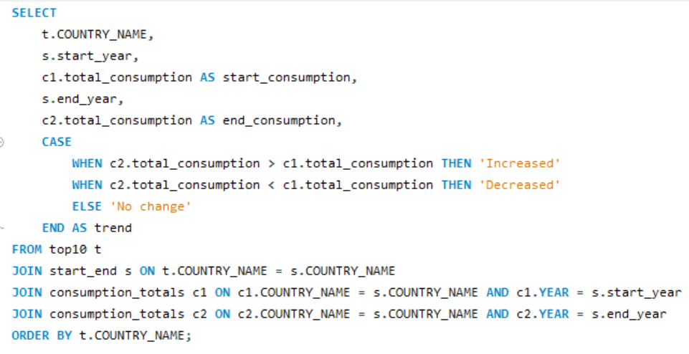
Trend Analysis Over Time

Slide 19
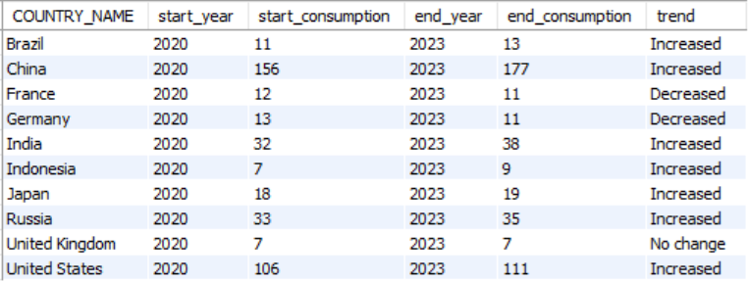
Trend Analysis Over Time

Slide 20
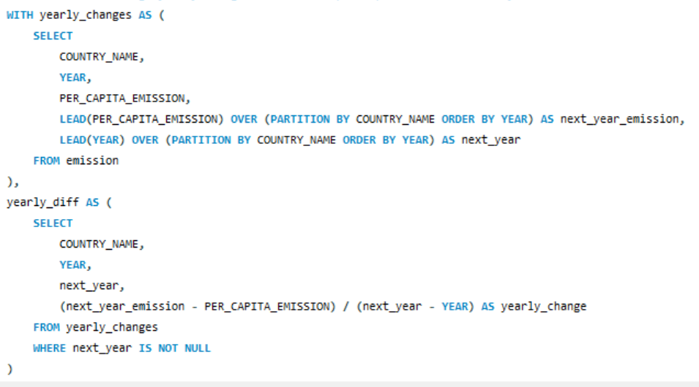
5. What is the average yearly change in emissions per capita for each country?
Trend Analysis Over Time

Slide 21
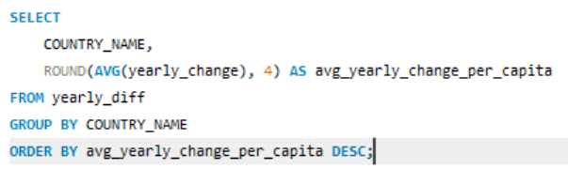
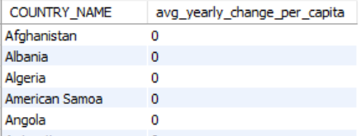
Trend Analysis Over Time

Slide 22
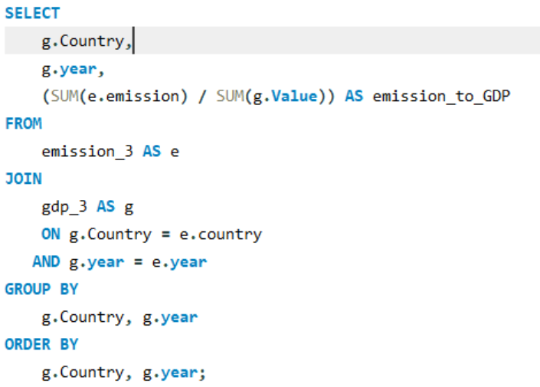
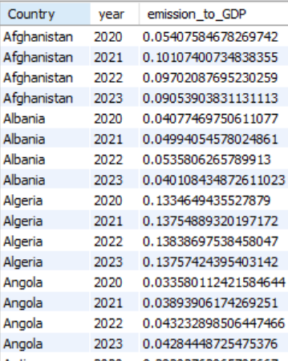
1. What is the emission-to-GDP ratio for each country by year?
Ratio & Per Capita Analysis

Slide 23
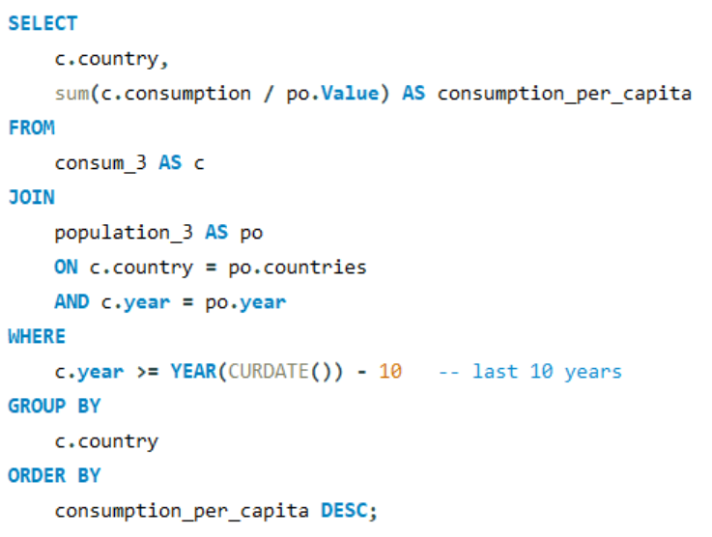
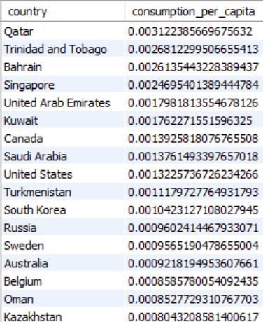
2. What is the energy consumption per capita for each country over the last decade?
Ratio & Per Capita Analysis

Slide 24
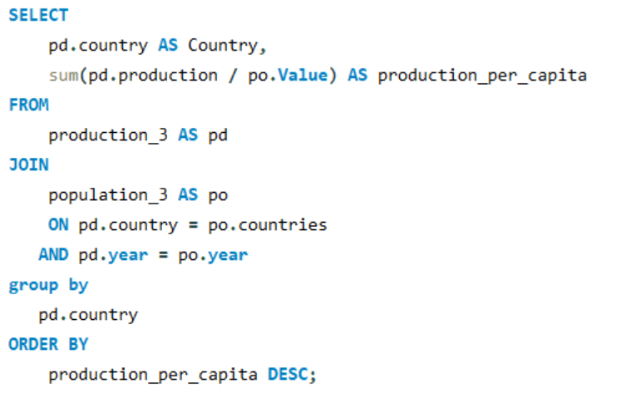
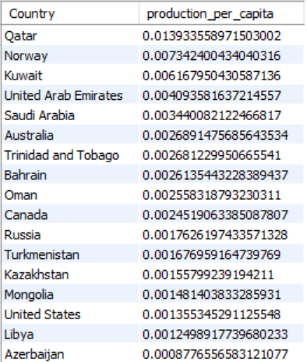
3. How does energy production per capita vary across countries?
Ratio & Per Capita Analysis

Slide 25
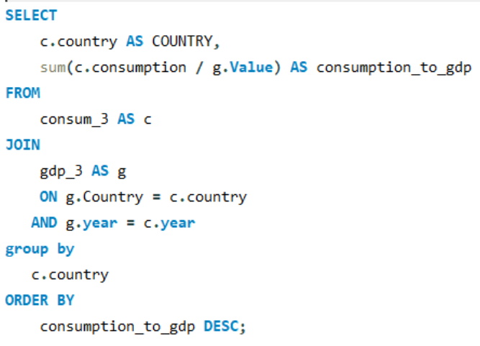
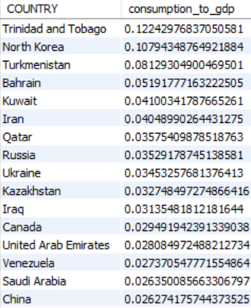
4.Which countries have the highest energy consumption relative to GDP?
Ratio & Per Capita Analysis

Slide 26
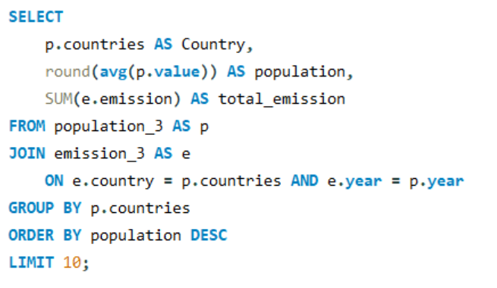
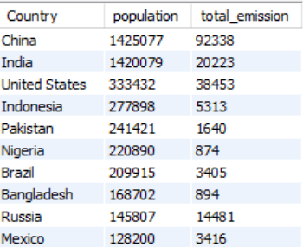
1. What are the top 10 countries by population and how do their emissions compare?
Global Comparisons

Slide 27
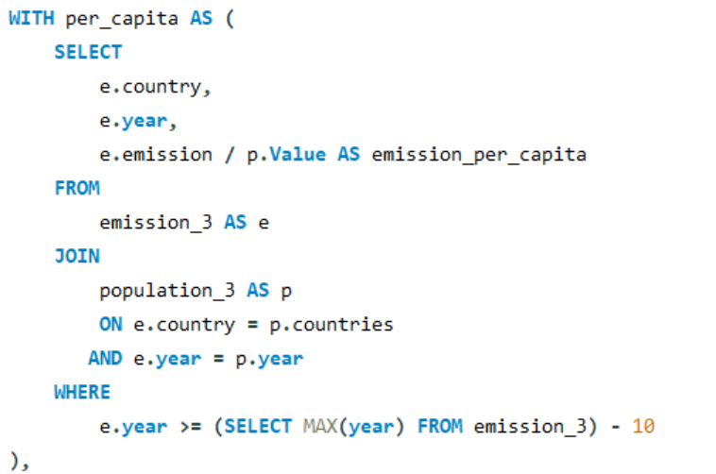
Global Comparisons
2. Which countries have improved (reduced) their per capita emissions the most over the last decade?

Slide 28
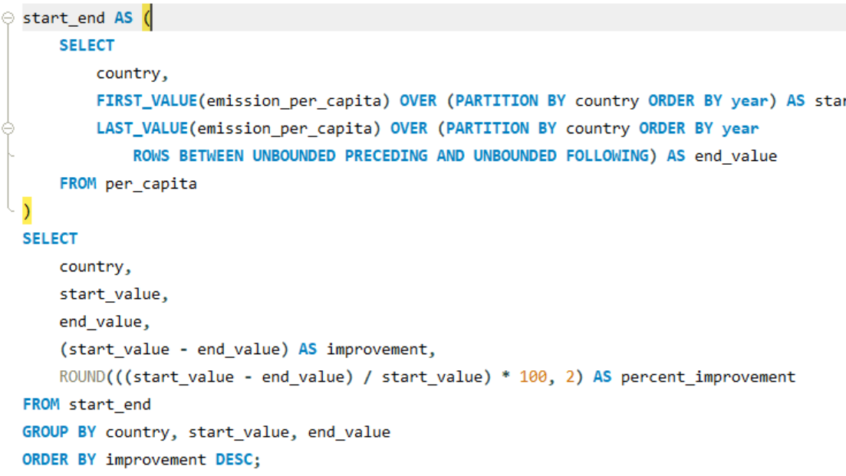
Global Comparisons

Slide 29
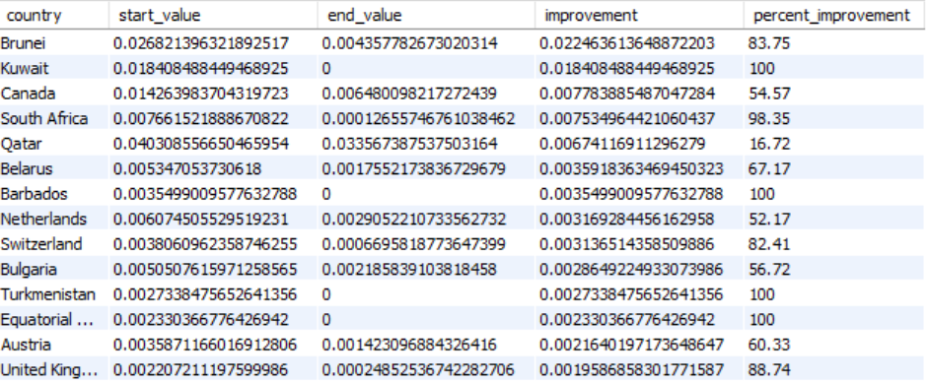
Global Comparisons

Slide 30
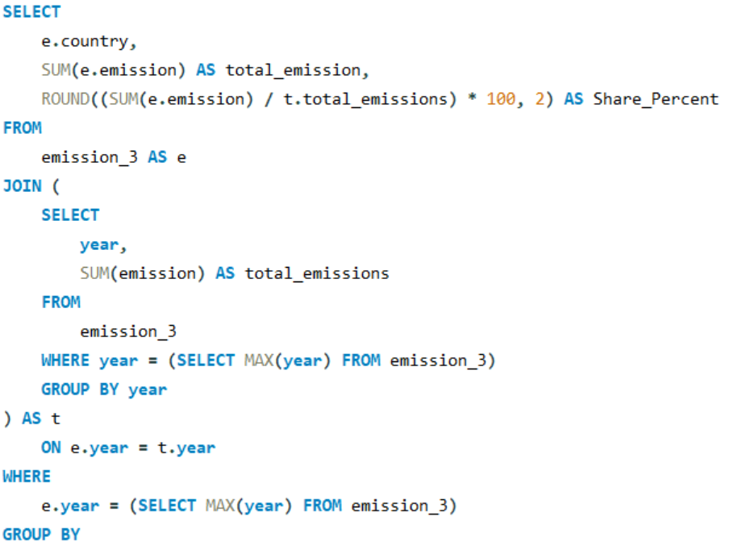
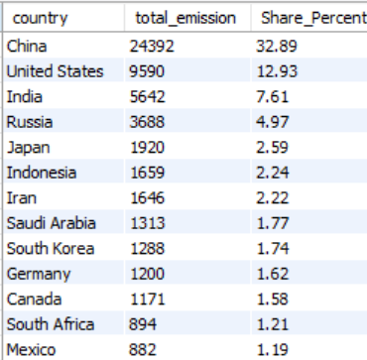
Global Comparisons
3. What is the global share (%) of emissions by country?

Slide 31
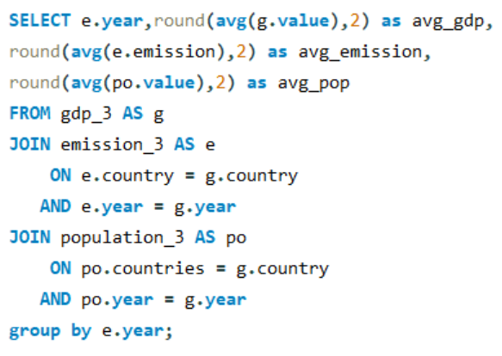
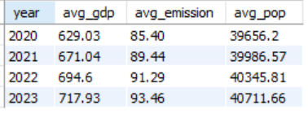
Global Comparisons
4. what is the global average GDP, emission, and population by year?

Slide 32
Conclusion
The SQL analysis revealed clear links between economic power, energy usage, and environmental impact.
Fossil fuels remain the primary source of emissions, with significant differences across countries.
Per capita metrics provide a fairer comparison than total values, exposing hidden high-impact countries.
Production–consumption gaps highlight net exporters and import-dependent nations.
Insights gained can help shape sustainable energy policies and guide global environmental strategies.

Slide 33

Thank you
Group Members:
S. V. Govinda Raju
Likitha Velugoti
Kalloji Rajesh

